Slide 1
Nuclear Fuel Performance
NE-533
Spring 2022

Slide 2
Last Time
Metal fuel can go to high burnup, good accident performance, inherent safety, easy to make
Complex phase and composition environment
Rapid, substantial swelling, followed by fission gas release
Fission gas bubble behavior is very phase dependent
Observe constituent redistribution radially, in addition to axially varying microstructure
FCCI is a major factor in cladding failure, dependent upon thermodynamics and kinetics of a number of lanthanides, actinides and transition metals

Slide 3
Mechanistic Fuel Performance Modeling

Slide 4
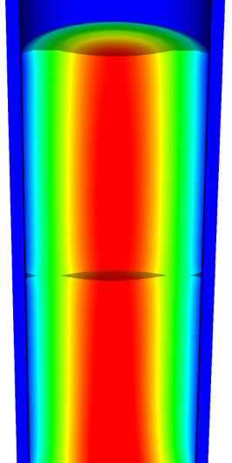
Going beyond burnup…
Operating Conditions
Neutron flux
Coolant T&P
Variables
Temperature
Displacement
Cladding
Property values
Fuel Property values
Fuel performance codes historically rely on materials models correlated to temperature and burn-up
Development has begun on models based on microstructure rather than burn-up
Elasticity tensor
Elasticity tensor
Burn-up
Yield stress
Thermal conductivity
Thermal conductivity
Fracture stress
Failure criteria
Melting temperature
Dimensional change
Diffusion constants
Gap conductance
Gap pressure
Dimensional change

Slide 5
Microstructure/Mechanistic/Multiscale
Mechanistic: relating to theories which explain phenomena in purely physical or deterministic terms
There is a drive for fuel performance codes to employ mechanistic materials models that are based on the current state of the evolving microstructure rather than burn-up
A series of state variables define the current state of the microstructure, and the evolution of these state variables is defined by mechanistic models that are functions of fuel conditions and other state variables
The material properties of the fuel and cladding are determined from microstructure/property relationships that are functions of the state variables and the current fuel conditions
Multiscale modeling and simulation is being used in conjunction with experimental data to inform the development of these models
This mechanistic, microstructure-based approach has the potential to provide a more predictive fuel performance capability

Slide 6
Multiscale Modeling
Modeling and simulation is the essential bridge from good science to good engineering, spanning from fundamental understanding of materials behavior to deliberate design of new materials technologies leveraging new properties and processes
Lower length scale modeling can provide insight, properties, mechanisms, behaviors, etc., that can be input into higher length scale modeling tools to describe, mechanistically, macroscale behavior

Slide 7
Density Functional Theory
DFT is a computational quantum mechanical modelling method used to investigate the electronic structure of many-body systems, in particular atoms, molecules, and the condensed phases
DFT is primarily utilized to investigate electronic structure, cohesive energy, elastic constants, phonons, entropies, etc.

Slide 8
Molecular Dynamics
MD is a computer simulation method for analyzing the physical movements of atoms and molecules, determined by numerically solving Newton's equations of motion for a system of interacting particles
MD is still atomistic, and is often utilized to calculate transport properties, melting temperature, clustering, etc., that are properties just beyond DFT capabilities

Slide 9
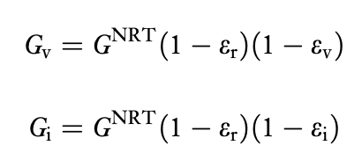
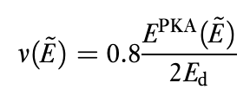
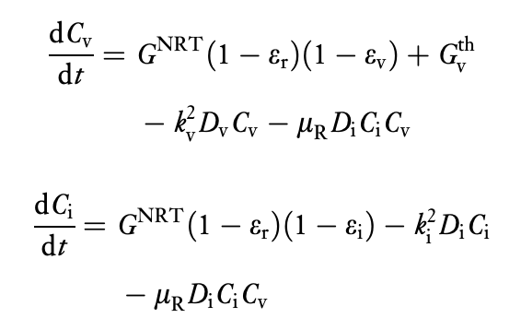
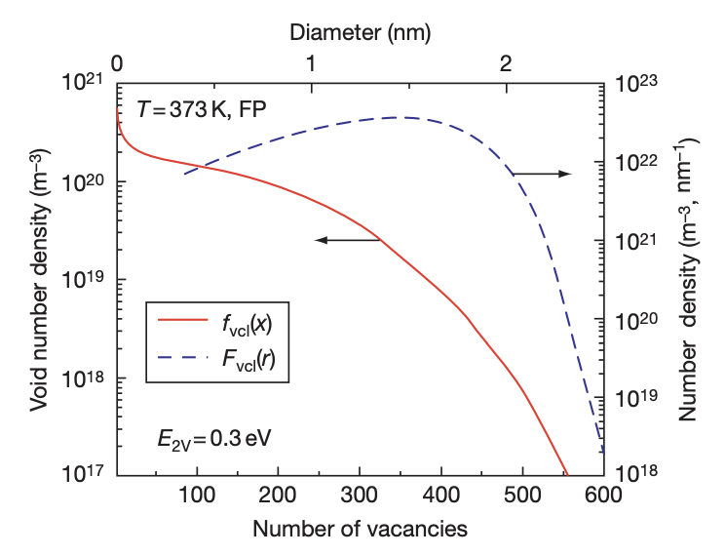
Rate Theory/Cluster Dynamics
Provides recipes for calculating reaction rates between individual species of the types which are ubiquitous in chemistry and physics
Is typically a mean-field approach which uses transition state theory as a tool for describing reactions involving radiation-produced defects
Can be utilized to describe clustering, absorption, emission, growth, resolution, etc. to describe microstructural phenomena on an intermediate time scale

Slide 10
Phase-Field
PF is mathematical model for solving interfacial problems that substitutes boundary conditions at the interface by a partial differential equation for the evolution of an auxiliary field (the phase field) that takes the role of an order parameter
The order parameter takes two distinct values (for instance 1 and 0) in each of the phases, with a smooth change between both values in the zone around the interface, which is then diffuse with a finite width
PF is commonly used for grain growth, phase separation, bubble coalescence, recrystallization, etc.

Slide 11

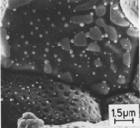
Microstructure-based fuel performance modeling
Structure/property relationships connect the microstructure variables to the property values
Operating Conditions
Neutron flux
Coolant T&P
Variables
Temperature
Displacement
Stoichiometry
Cladding
Property values
Microstructure evolution models
Microstructure evolution models
Fuel Property values
Elasticity tensor
Elasticity tensor
Grain growth
Grain growth
Cladding
Microstructure variables
Average grain size
Dislocation density
H concentration
Hydride fraction
Point defect concentrations
Loop density
2nd phase particle fraction
Fuel
Microstructure variables
Average grain size
Dislocation density
U defect concentrations
Pu concentration
Fission product precipitate fractions
Dissolved fission products
Fission gas bubble fraction
Grain boundary fission gas bubble coverage
Crack parameter
Plasticity
Plasticity
Thermal conductivity
Yield stress
Defect prod. & transport
Defect prod. & transport
Fracture stress
Thermal conductivity
Hydrogen transport
Fission gas behavior
Melting temperature
Failure criteria
Loop evolution
Densification
Diffusion constants
Dimensional change
Gap variable
Gap fission gas concentration
Fracture
Dimensional change

Slide 12

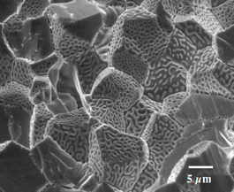
Example: fission gas behavior in the fuel
Take into account a finite set of variables to describe the state of the material
Utilize a mechanistic model of fission gas behavior to predict the evolution of the microstructure
Utilize this updated microstructure to inform a number of structure/property relationships
Variables
Temperature
Displacement
Stoichiometry
Elasticity tensor
Thermal conductivity
Model of fission gas behavior
Structure/property relationships
Fracture stress
Dissolved fission products
Fission gas bubble fraction
Grain boundary fission gas bubble coverage
Gap fission gas concentration
Dimensional change
Gap conductance
Gap pressure

Slide 13
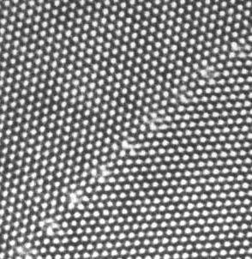
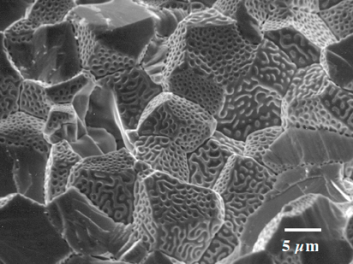
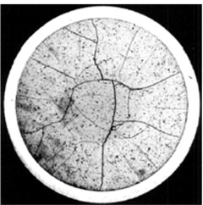
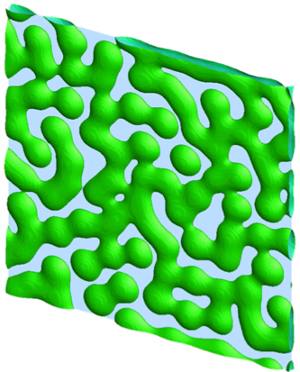
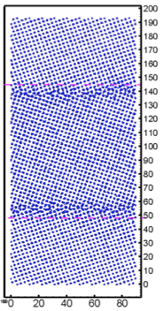
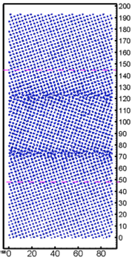
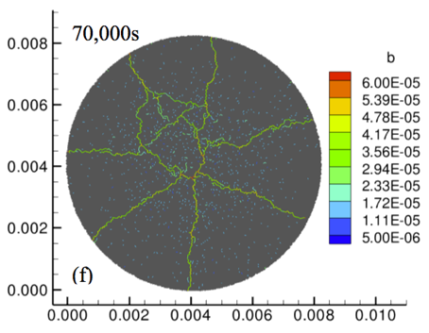
Multiscale separate effects experiments and simulations inform the development of the models
nm
μm
mm

Slide 14
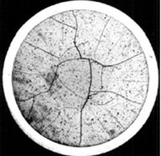
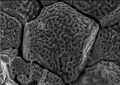
Microstructure-based models
Can provide a structure/property relationship to replace the existing burnup dependent model
For example, thermal conductivity, taking into account microstructural features and their evolution
Grain boundary and bubbles
Intragranular porosity
Precipitated fission products
κ_{pr}
Bulk conductivity
Vacancies and interstitials
Fission gas

Slide 15
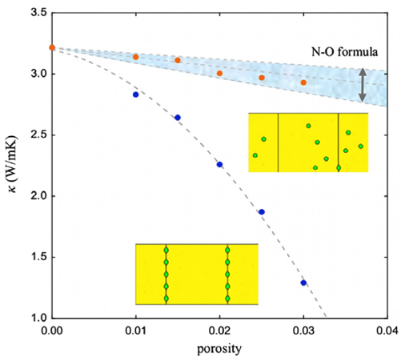
Parametrizing the mechanistic model
We employ multiscale modeling and simulation to determine the various parameters for the model
MD simulations conducted at LANL have been used to determine the coefficients for various point defects
MD simulations have shown that phonon scattering must be accounted for to accurately represent small bubbles
Mesoscale simulations have shown that GB bubbles have a larger impact on the thermal conductivity
Maxwell-Eucken (no phonon scattering)

Slide 16
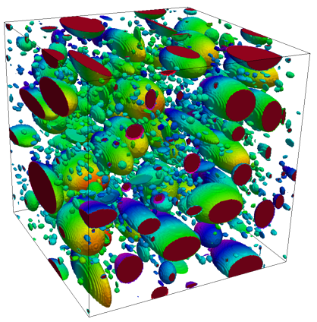
Parametrizing the mechanistic model
A thermal resistor model is created to describe the impact of GB bubbles on the thermal conductivity
MARMOT simulations are currently being used to inform the development of the precipitate multiplier

Slide 17
Parametrizing the mechanistic model
Each term in the expression must be coupled to a corresponding state variable
The full model calculates the thermal conductivity as a function of:
Temperature
Point defect concentrations
Intragranular bubble density and average radius
Fractional coverage of bubbles on GBs and average radius
Precipitate volume fractions and average sizes
Currently effects of precipitates fission products and individual point defects are neglected in the model, as they are not tracked or predicted in BISON

Slide 18
Comparing with experiments…
The model under-predicts the temperature in most cases, but not all
Thus, the model is neglecting some resistive effects from the microstructure
But generally performs as well, and in some cases better, than the burnup based model
RISO-3 AN3
RISO-3 AN4
RISO II-3
US PWR TSQ0002

Slide 19
UZr Fuel Performance Modeling
Development of a quantitative phase-field model of macroscale constituent redistribution in the U-Zr system, where model parameters were optimized and the model validated against an independent data set
Calculation of surface tension based on molecular dynamics, which is used in the BISON gaseous metallic fuel swelling model

Slide 20
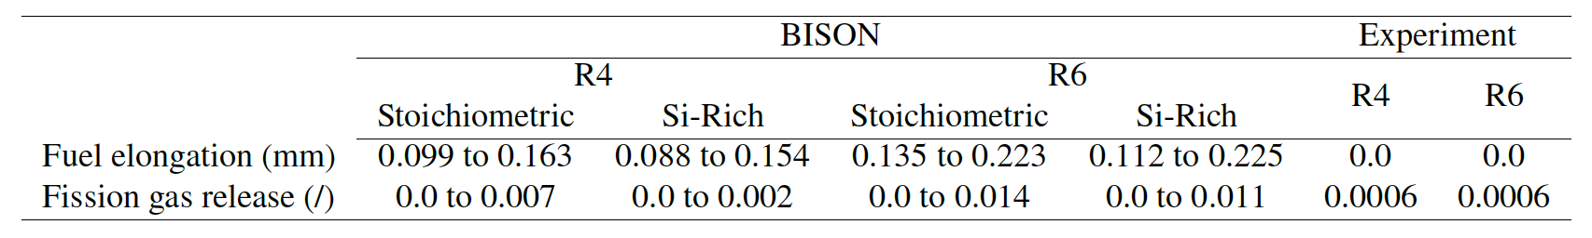
U3Si2 Fuel Performance Modeling
Point Defect Diffusion, Fission gas swelling, thermal and irradiation creep

Slide 21
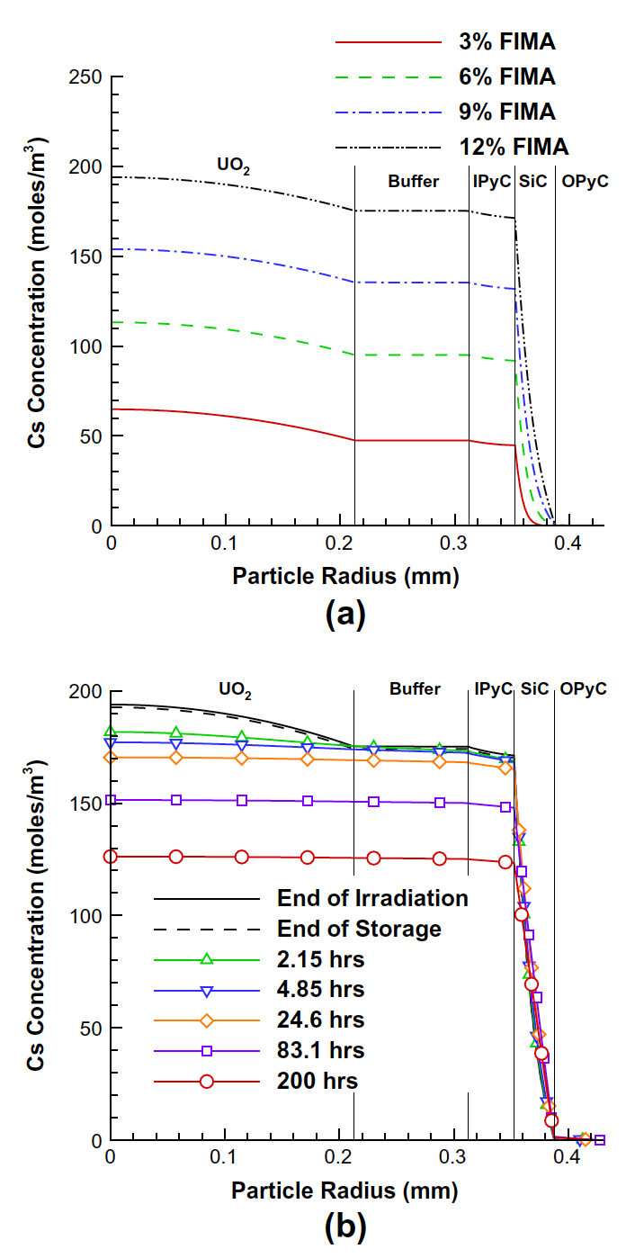
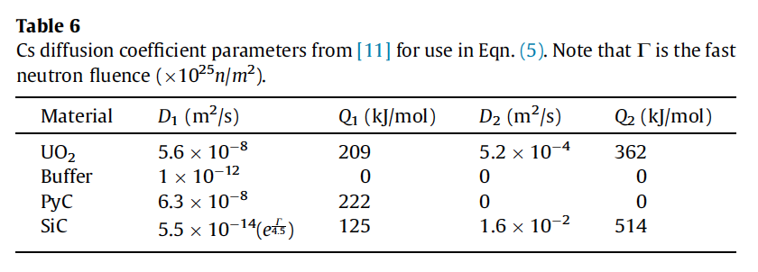
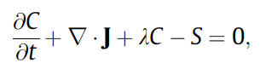
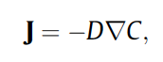
TRISO Particle Fuel Performance Modeling
TRISO particle modeling is still under development from a mechanistic model standpoint
Imperfect data for many critical fission products through different layers
Data typically for UO2 only, not for UC or UCO fuel kernels

Slide 22
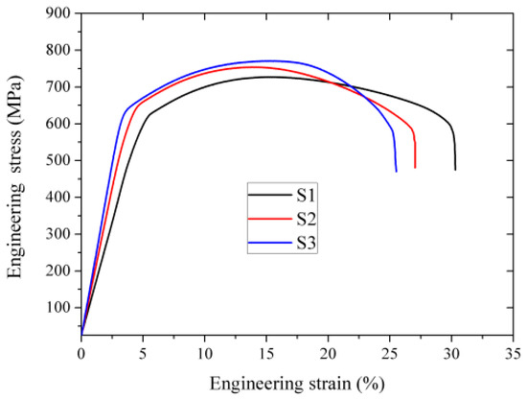
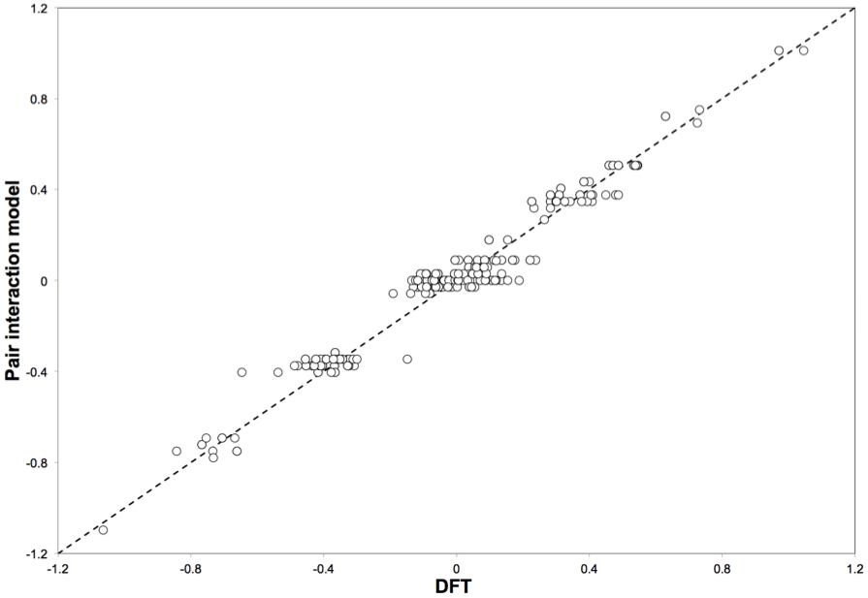
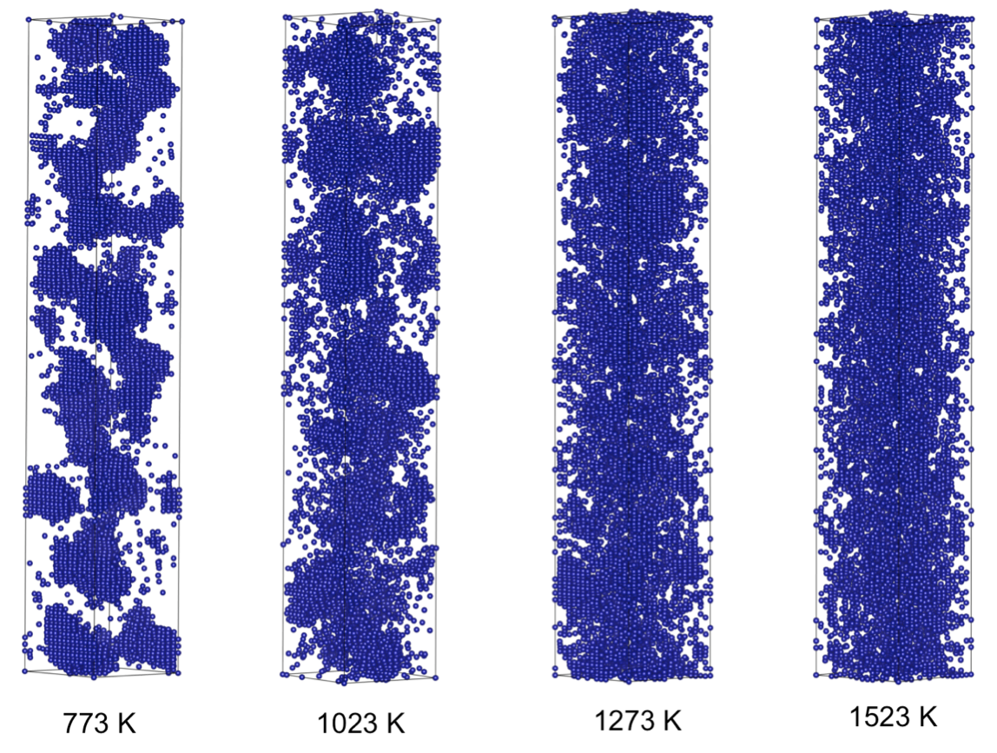
FeCrAl
Evolution of compositional randomness (precipitation) will affect the mechanical properties of FeCrAl
Kinetic Monte Carlo simulations modeled the precipitation of alpha’ phase from bcc Fe-Cr alloys under thermal aging at various temperatures
Fe-Al alloys do not show any phase separation
Can determine critical temperatures for precipitation and the resulting microstructures to investigate potential hardening

Slide 23
Summary
Researchers are working to develop materials models for the fuel and cladding that are mechanistic rather than empirical and that are based on the evolution of the microstructure rather than the burnup.

